Slide 1
Legacy BOM Import
June 2024

Slide 2
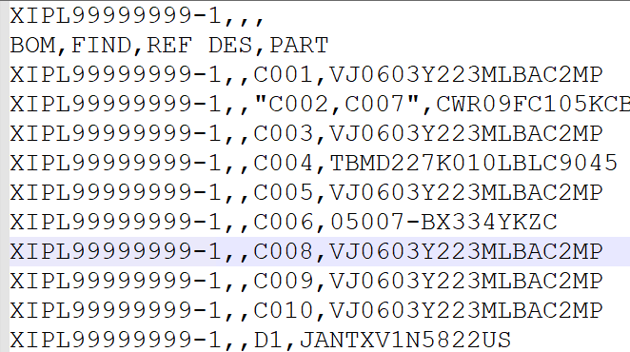
Feature 1: CSV Format
Current Process
Users need to transform the exported data from the source tool to the acceptable format of the Legacy BOM tool. There is no support for a CSV format.
New Process with the Improved Legacy BOM
The Tool now supports a CSV format, which will reduce the user's manual effort to load the BOM into Teamcenter. Supports Multiple Ref des
Added Business Value:
Higher productivity (ability to handle inhouse exported BOM structure).
Improved time to build structure.
Notes:
CSV format must follow the template shown in the snapshot.
Supports all the features that are enables for XLSX type like, multiple ref des, auto population of find number.

Slide 3
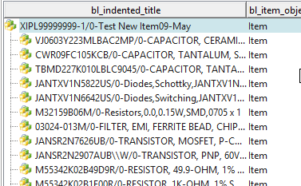
Feature 2 : Support for Multiple Parent Item Types
Current Process
Only PCA type BOM imports are enabled.
New Process with the Improved Legacy BOM
All types of BOM imports are enabled.

Slide 4
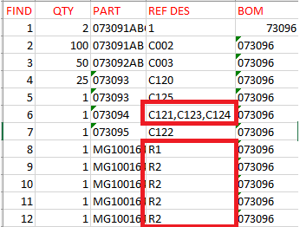
Feature 3 : Multiple Reference Designators
Current Process
The User must enter reference designators separately, for the same part.
New Process with the Improved Legacy BOM
Users can enter multiple reference designators with a comma separating each designator as shown to the right.
Added Business Value:
Improved readability
.

Slide 5
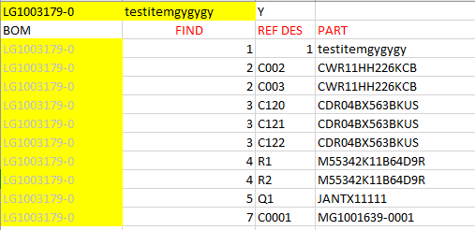
Feature 4 : New .xlsx Format
The tool now supports another .xlsx format.
Existing Format
New Format

Slide 6
Additional Features
Since the multi-field key is enabled, the population of Import Data on the tool User Interface (UI), will always put precedence on Legacy Items over Vendor Part Items.
Improved performance by 300 % ( from 3 Hrs. to <10 min).

